Slide 1
Designing Advanced Data Architecture for BI
IMDb Data and Analysis Project
Team Members:
Shrivallabha Kulkarni
Niramay Kelkar
Pooja Vaikos

Slide 2
Staging
Input sources:
Tsv files
Mysql
Rejections based on duplicate data was eliminated using tUniqRow and using variables in tMap
Special characters (like |, $, \N etc) were eliminated by passing empty values and marked as null using tMap

Slide 3
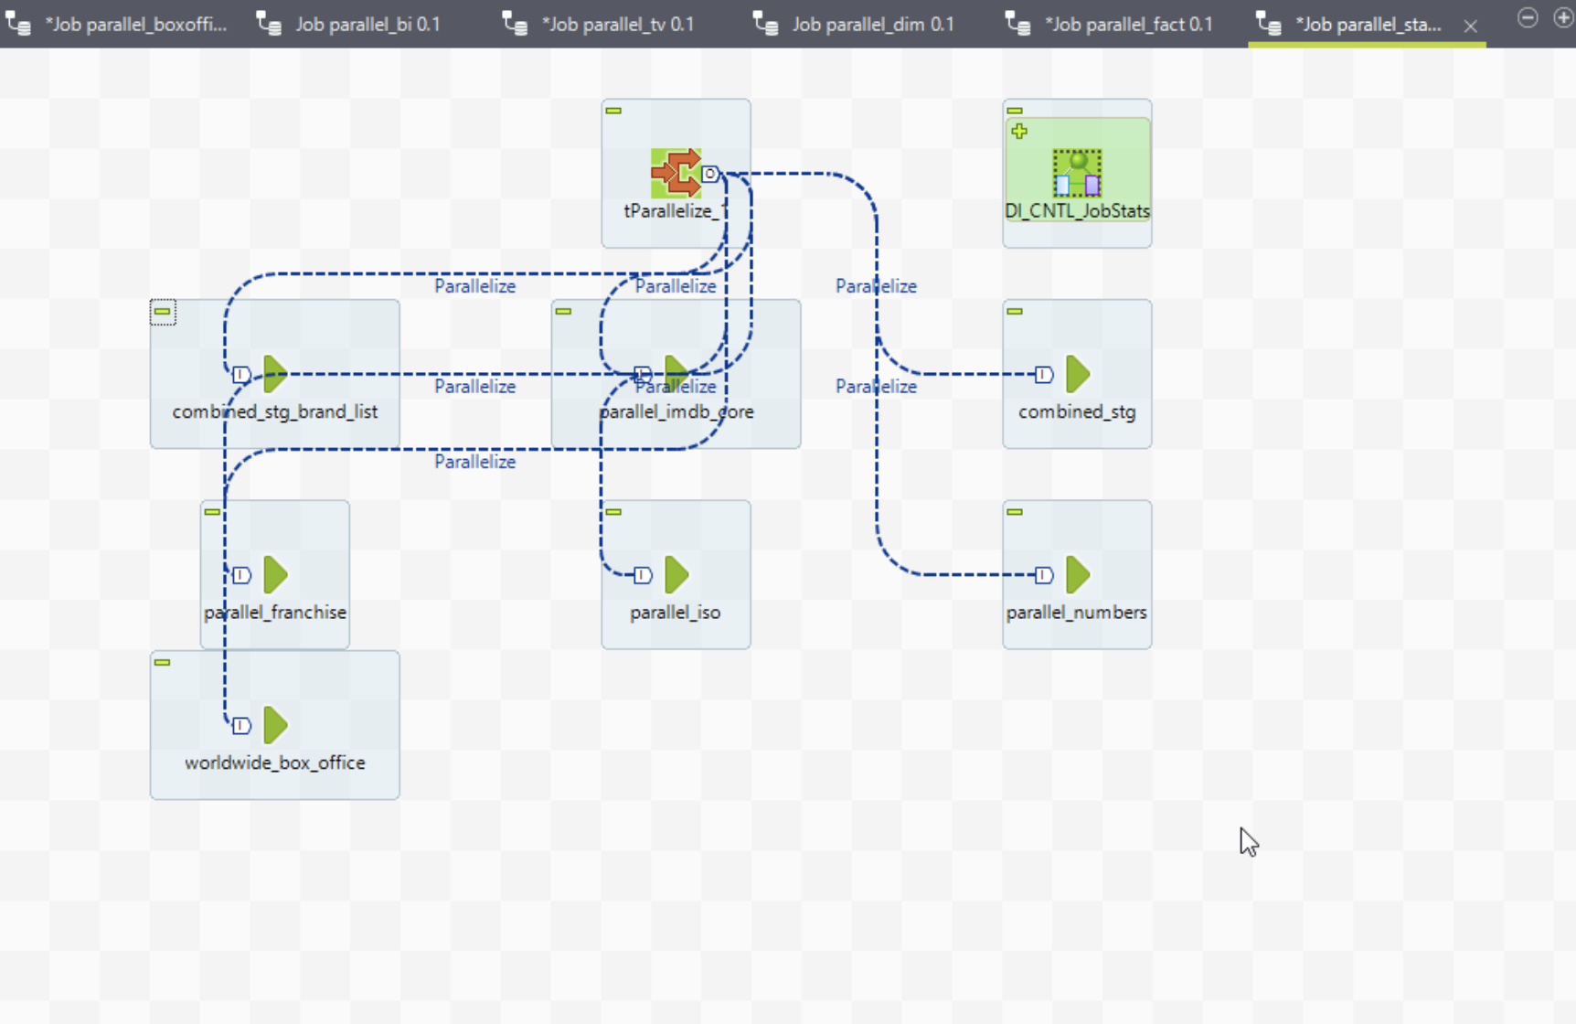
Staging Master Job

Slide 4
Integration
Input sources:
MS SQL
The null values in input sources for key columns if there were any and normalized the data from tables such as genres, crew to be ingested into BI schema tables

Slide 5
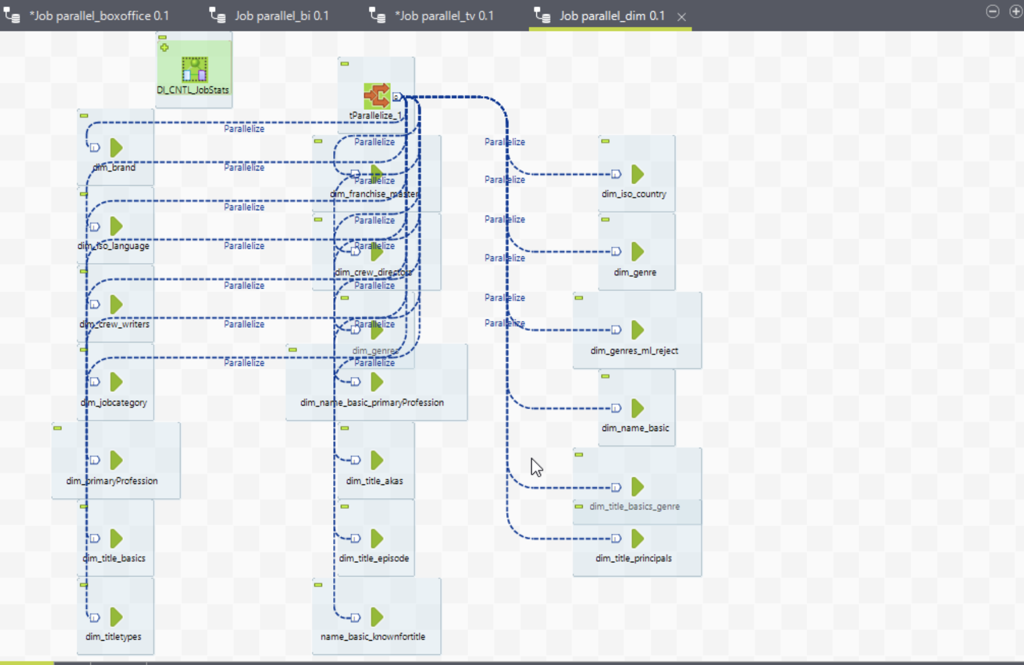
Integration Dim Master Job

Slide 6
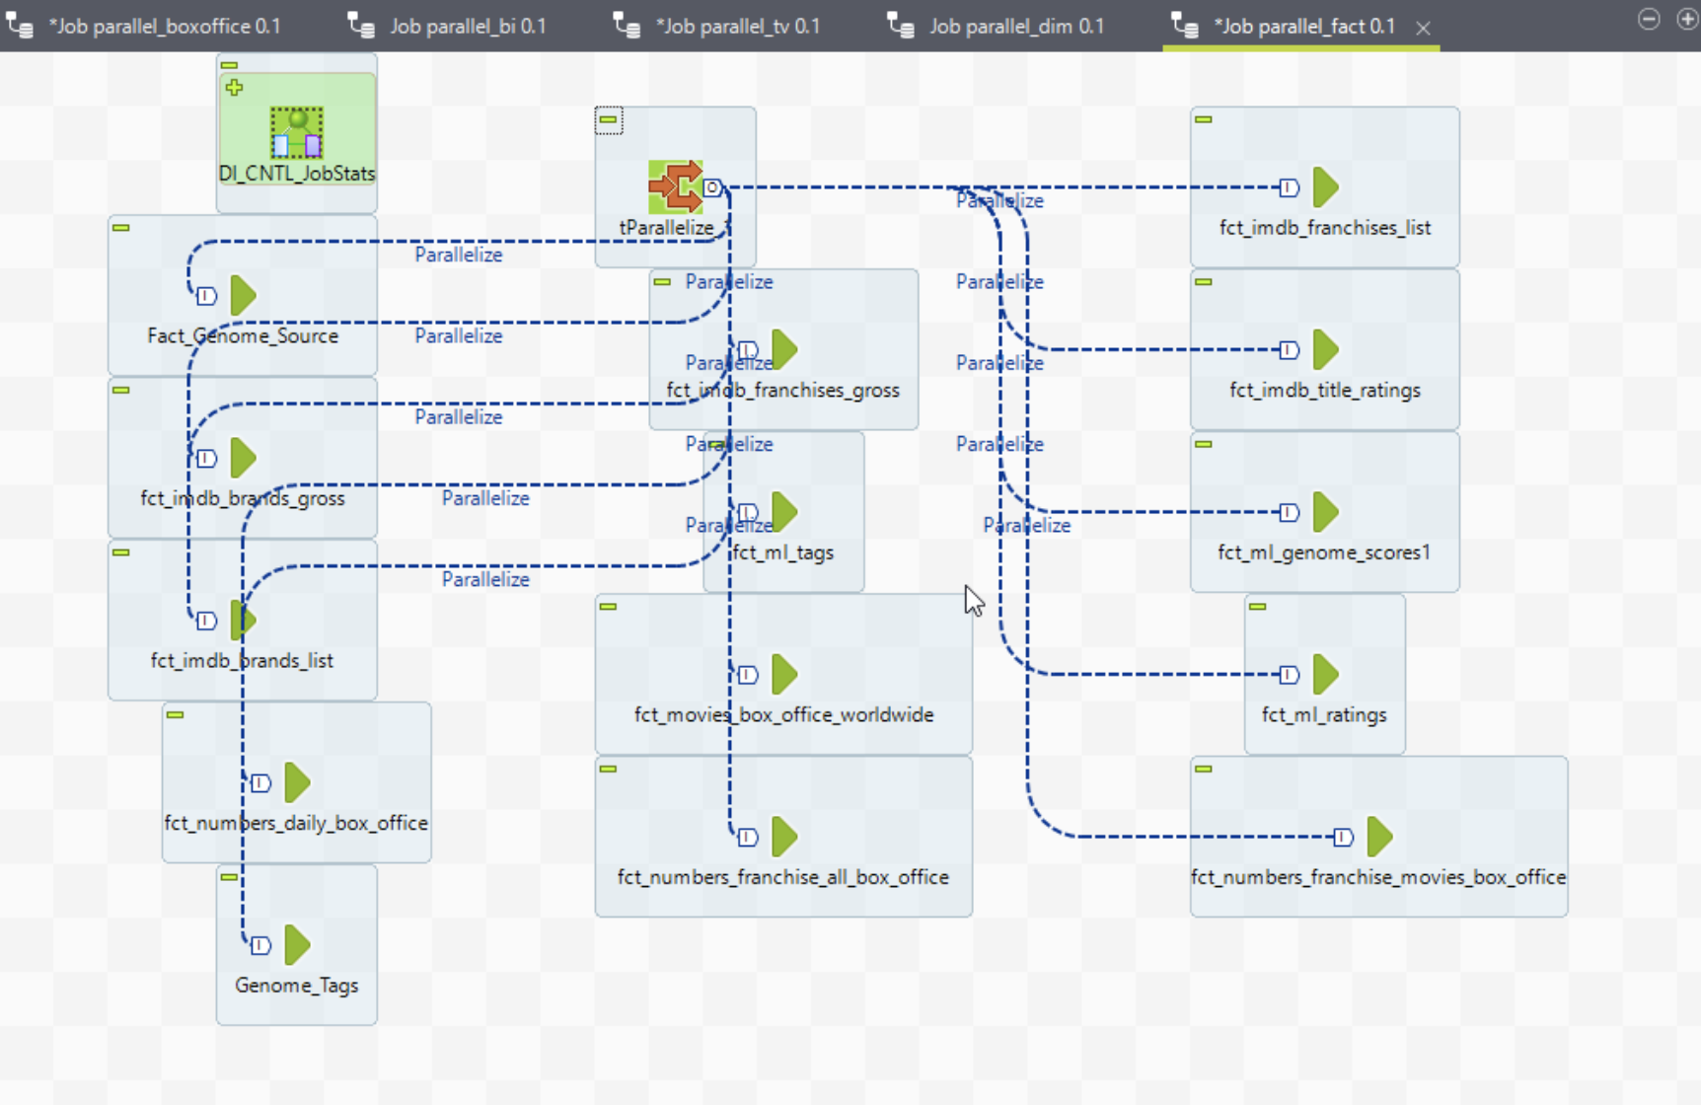
Integration Fact Master Job

Slide 7
BI
Input sources:
Integration tables
Data filtration based on the required BI schema was attempted for top 1k movies and TV shows

Slide 8
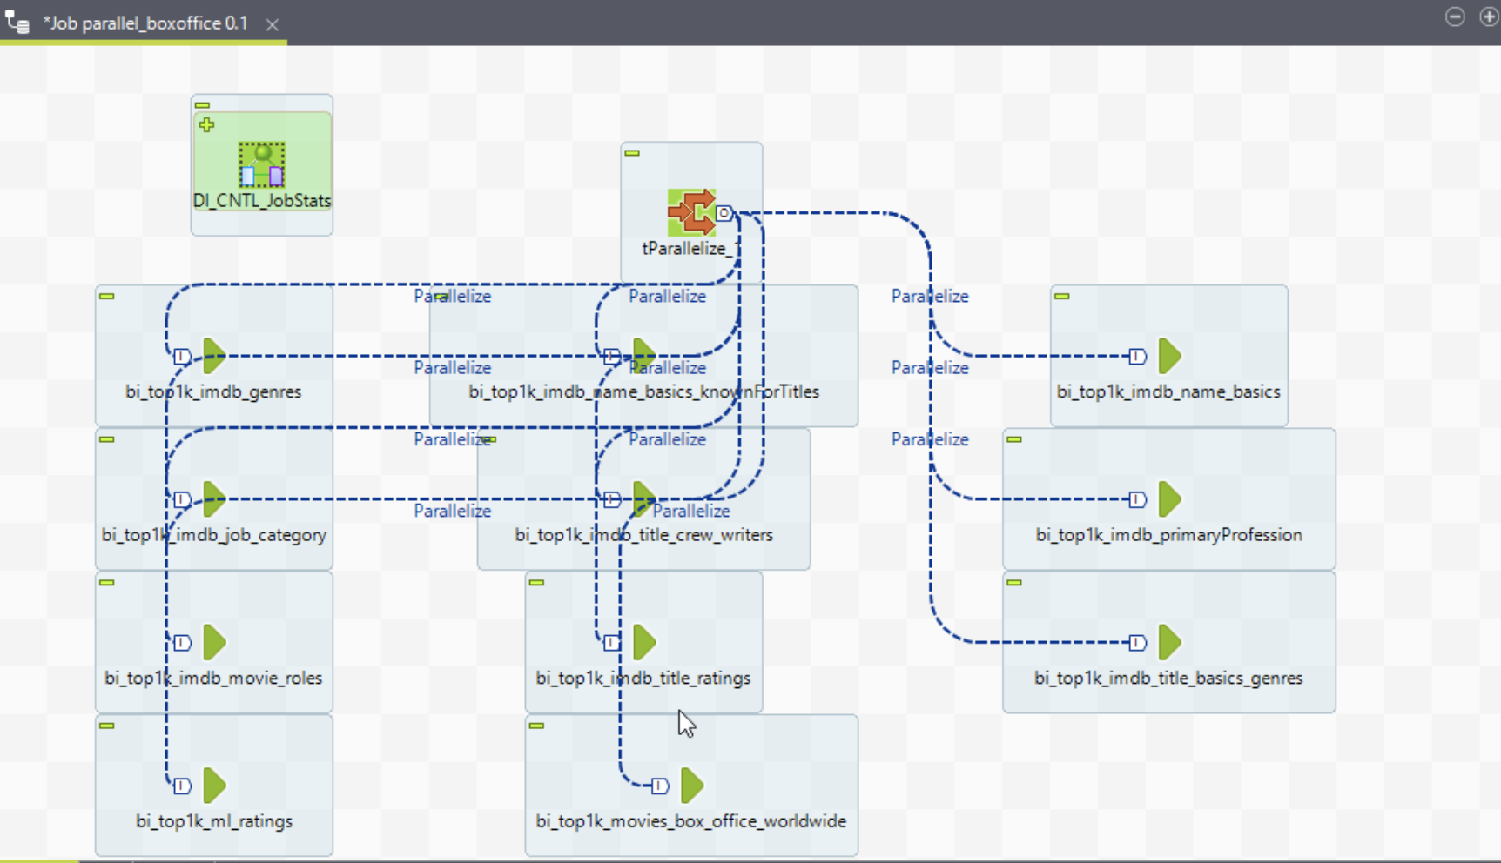
BI Master Job (Movies)

Slide 9
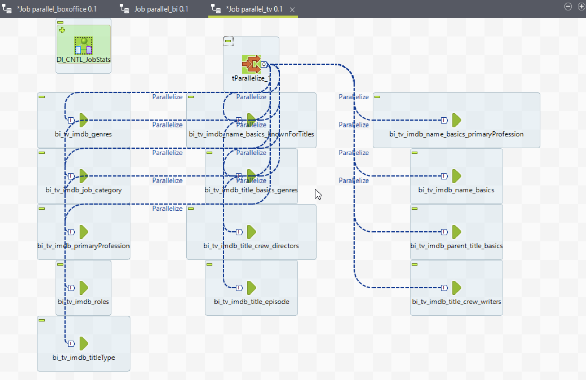
BI Master Job (TV)

Slide 10
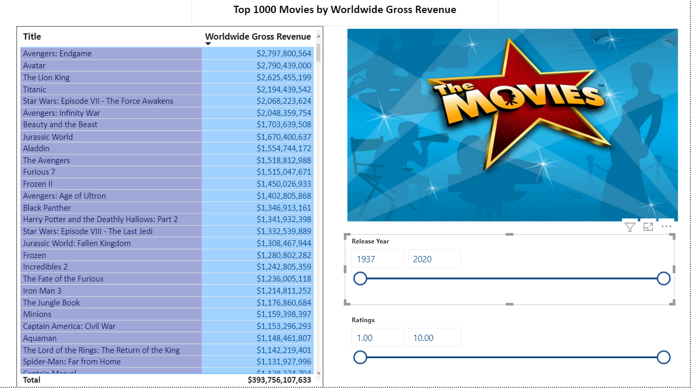
BI Dashboards

Slide 11
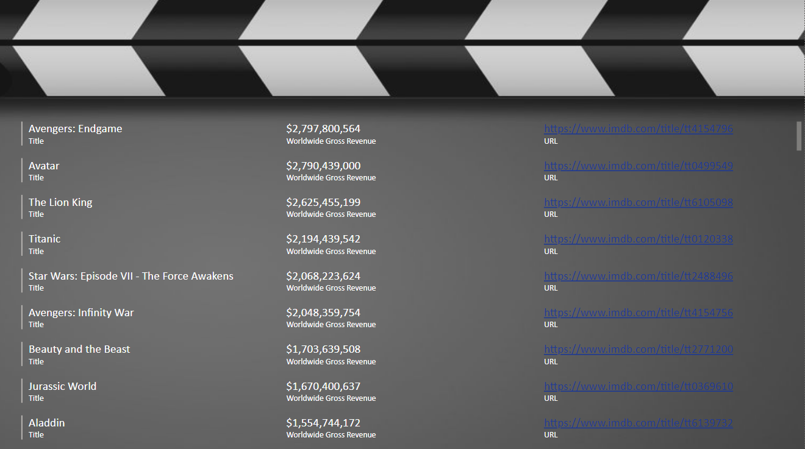
Top 1000 Movies by URL

Slide 12
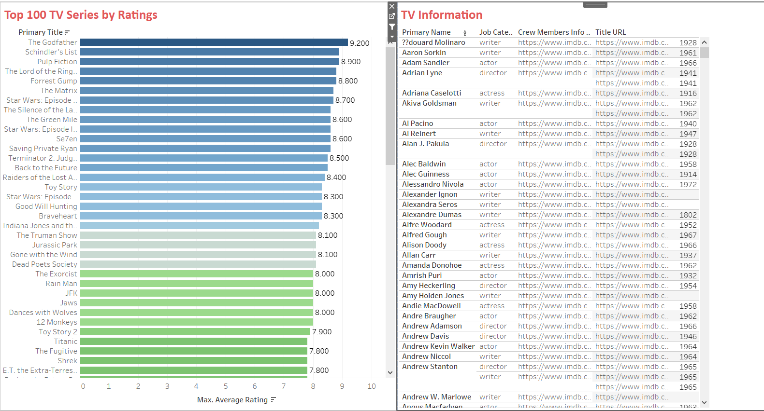

Slide 13
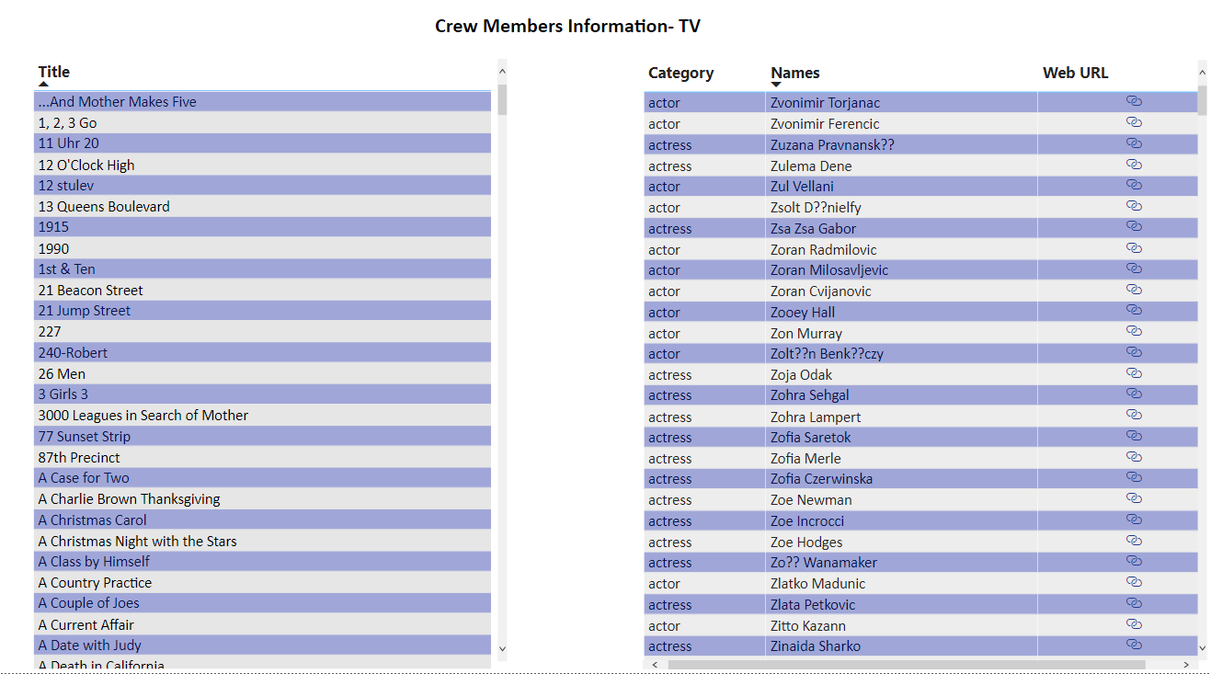

Slide 14
Improvements
Performance tuning
Improved parallelization

Slide 15
Thank you!

